Slide 1


Enhancing User Engagement via News Multi-Class Classification
Notes:
Good Afternoon, everyone. Thank you for being here today."
"My name is [Your Name], and I'm excited to present my capstone project titled:"
"Enhancing User Engagement for news platform Multi-class Classification"
"In the next few minutes, I'll show you how we're enhancing user engagement through smart news classification

Slide 2
Index
Introduction
Business Problem
Objective
Project Workflow
Dataset Overview
Exploratory Data Analysis
Data Preparation
Model Performance Comparison
Challenges
Future Scope
Appendix
Copyright © 2023 Grazitti Interactive. The Information on the deck is proprietary to Grazitti Interactive.
Any reproduction or distribution of the content without the company's consent is prohibited and may cause legal action.
‹#›
Notes:
Before we dive deep, let me give you a roadmap of our journey today. We'll start with the company background, understand the problem we're solving, and walk through our solution - from data analysis to model implementation. I'll also share some interesting challenges we faced and our vision for the future.

Slide 3

News Firm Introduction &
Business Problems Faced By The Firm
Copyright © 2023 Grazitti Interactive. The Information on the deck is proprietary to Grazitti Interactive.
Any reproduction or distribution of the content without the company's consent is prohibited and may cause legal action.
‹#›
Notes:
Let's begin by understanding the company and the biggest challenge they're facing

Slide 4
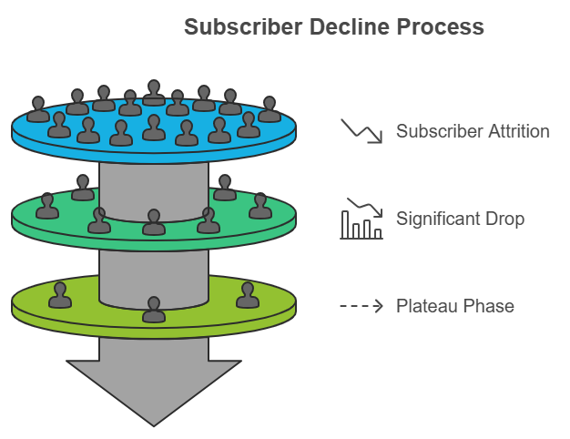
Company Overview & Challenges
About Inshorts
Leading news aggregation platform.
Transforms news into 60-words or lesser bite-sized formats.
Challenges Faced by the Company
Manual Processing of News Articles
Misclassification of Articles
Declining User Engagement
Copyright © 2023 Grazitti Interactive. The Information on the deck is proprietary to Grazitti Interactive.
Any reproduction or distribution of the content without the company's consent is prohibited and may cause legal action.
‹#›
Notes:
It is one of the leading news aggregation platforms in the market. [Pause]
What makes them unique? They transform complex news stories into bite-sized formats of just 60 words or less. Think of it as getting the essence of news in the time it takes to drink your morning coffee!
However, [change tone to indicate transition to challenges] they're facing significant challenges that are impacting their business: One of the biggest challenges they're dealing with is the decline in user engagement. Subscriber numbers are dropping, and user activity on the platform is waning. This is a major concern for them, and it’s something we need to address.

Slide 5
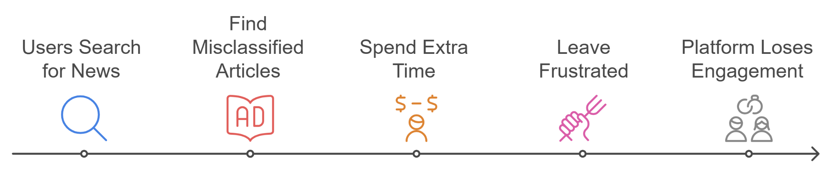
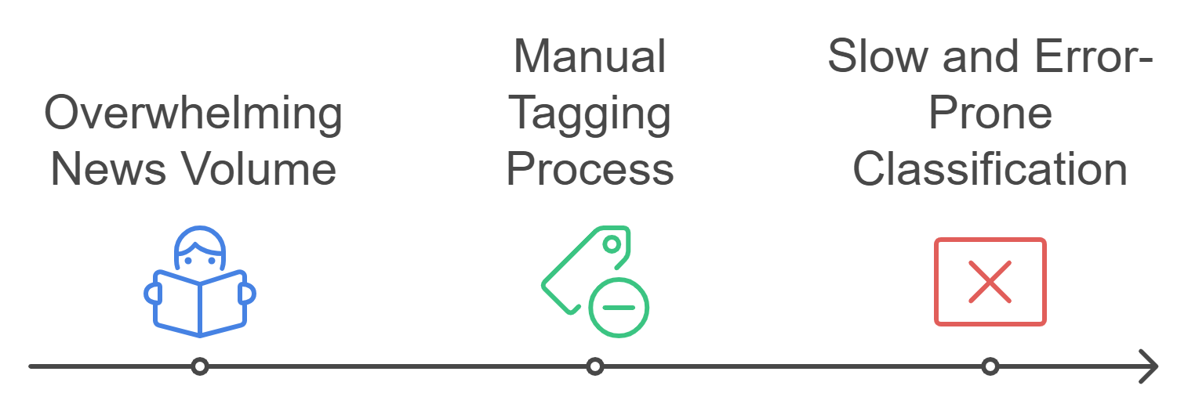
Why is User Engagement Declining ?
User Frustration Cycle
Why is This Happening?
Copyright © 2023 Grazitti Interactive. The Information on the deck is proprietary to Grazitti Interactive.
Any reproduction or distribution of the content without the company's consent is prohibited and may cause legal action.
‹#›
Notes:
Let me walk you through what we call 'The Frustration Cycle Picture this: A user visits the platform, expecting personalized technology news. Instead, they find a sports article incorrectly tagged as tech. They waste precious time searching, get frustrated, and eventually leave. This scenario repeats thousands of times daily. Why is this happening? With over 1,000 articles published daily, manual tagging team is overwhelmed. They're racing against time to categorize news quickly, leading to errors and misclassifications.

Slide 6

Machine Learning: The Future of News Classification
Copyright © 2023 Grazitti Interactive. The Information on the deck is proprietary to Grazitti Interactive.
Any reproduction or distribution of the content without the company's consent is prohibited and may cause legal action.
‹#›
Notes:
Now that we understand the problem, let's explore our solution – an ML system that automatically categorizes news articles The solution we've developed tackles both sides of the problem: For Users:
Instant access to accurately categorized news, enabling them to find relevant content effortlessly
For Organizations:
Fully automated classification system that scales with growing content volume
Dramatic reduction in manual workload.

Slide 7
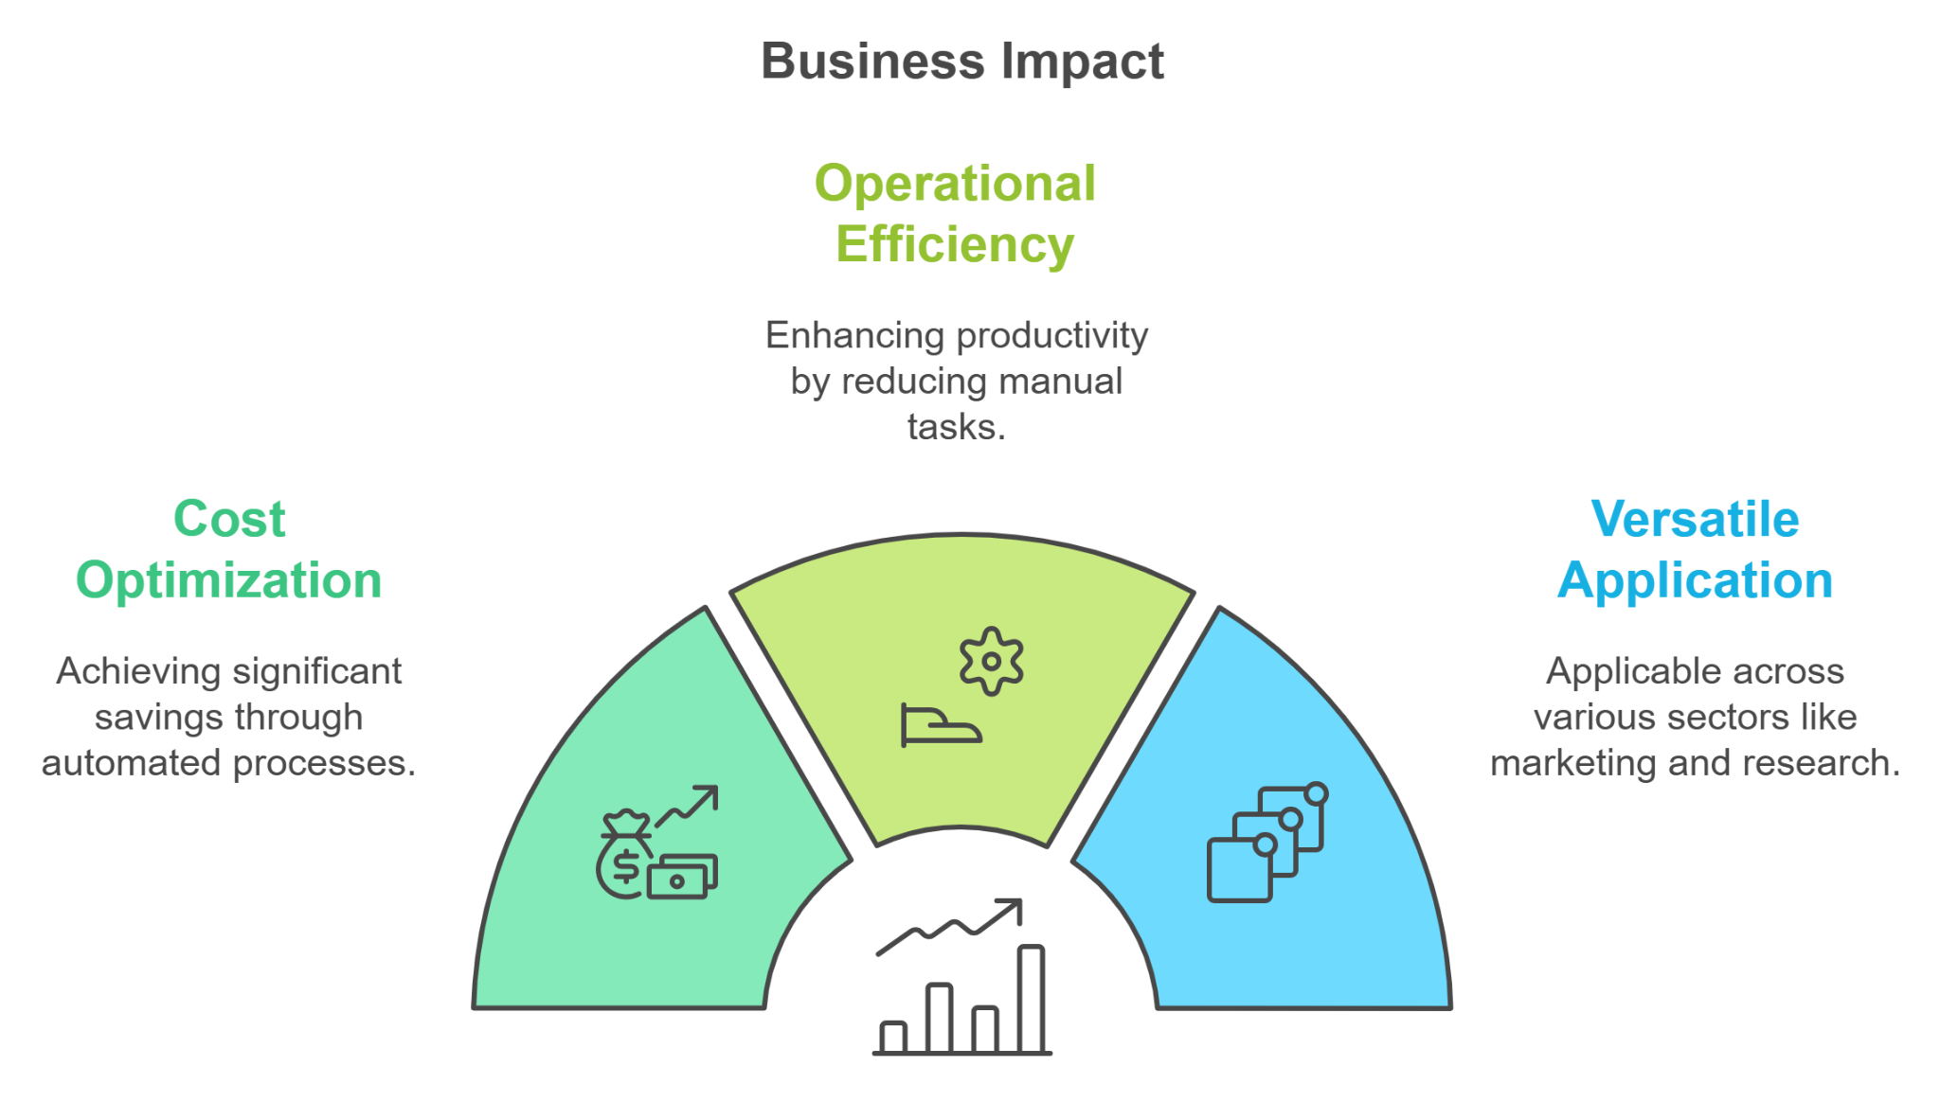
What is News Multi-Class Classification ?
An intelligent system that automatically categorizes news articles into predefined classes.
It leverages advanced ML techniques for accurate classification.
Real-time categorization of incoming news articles.
Copyright © 2023 Grazitti Interactive. The Information on the deck is proprietary to Grazitti Interactive.
Any reproduction or distribution of the content without the company's consent is prohibited and may cause legal action.
‹#›
Notes:
Let me break down our solution in simple terms. [Engage audience with a conversational tone]
What exactly is News Multi-Class Classification? [Rhetorical question] Imagine having an intelligent assistant that reads every news article the moment it arrives and instantly knows exactly where it belongs. [Paint a relatable picture] That's precisely what our AI-based system does - it automatically categorizes incoming news articles into predefined classes, whether it's sports, technology, politics, or business.
[Transition to technical aspect with enthusiasm] We're leveraging advanced machine learning models that can understand the content of each article, ensuring accurate classification in real-time.
[Lean forward slightly, showing excitement for business impact] Now, here's where it gets really interesting - let's look at the business impact:
First, Cost Optimization: [Use hand gesture] We're significantly reducing the manual workforce needed for classification, cutting operational costs by automating this process.
Second, Operational Efficiency: [Another deliberate hand movement] What used to take hours is now done in seconds. News articles are classified instantly as they arrive, ensuring fresh content reaches users without delay.
Finally, Versatile Application: [End with the broader perspective] This system isn't just limited to news classification. It can adapt and learn new categories, making it a future-proof solution for evolving content needs."

Slide 8
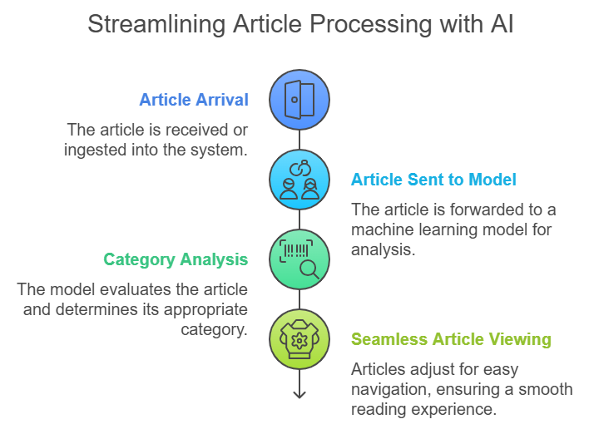
Technical Solution
Develop Accurate Classification Models
Build an AI model to automatically classify news articles.
Continuous Model Improvement
Automatically retrain the classification model with new articles to enhance accuracy.
Copyright © 2023 Grazitti Interactive. The Information on the deck is proprietary to Grazitti Interactive.
Any reproduction or distribution of the content without the company's consent is prohibited and may cause legal action.
‹#›
Notes:
"Now, let me walk you through how our solution works in practice. [Enthusiastic tone]
Our primary goal was to develop highly accurate classification models. [Pause] Think of it as training a highly specialized news expert that never gets tired. [Relatable analogy] This AI model can read, understand, and categorize news articles faster than you can say 'breaking news'!
.
Let me show you the streamlined process: [Use hand gestures to illustrate flow]
First, an article arrives on our platform
It's instantly sent to our AI model
The model analyzes and determines its category
And finally, it's seamlessly delivered to the right section
All of this happens in mere seconds!" [End with impact]
As my model will classify news article correctly, this will break the user frustration cycle.

Slide 9

Process Pipeline
Copyright © 2023 Grazitti Interactive. The Information on the deck is proprietary to Grazitti Interactive.
Any reproduction or distribution of the content without the company's consent is prohibited and may cause legal action.
‹#›
Notes:
Now, let’s dive into the pipeline to understand the solution’s process.

Slide 10





Technical Workflow
20XX
Introduction
EDA
Data Preparation
Machine Learning
Model Evaluations
Gathering Data
Overview of Data
Handle Missing & Duplicate Values
Category Frequency Analysis
Time Series Trends
Word Frequency Analysis
Remove Stop Words, Digits, Punctuation
Lemmatization & Word Tokenization
Deal with Class Imbalance
Train - Test Split
Traditional ML Models
Deep Learning Model
Transfer Learning Model
Evaluates and Compare the Models
Champion Model & Hyperparameter
Copyright © 2023 Grazitti Interactive. The Information on the deck is proprietary to Grazitti Interactive.
Any reproduction or distribution of the content without the company's consent is prohibited and may cause legal action.
‹#›
Notes:
Let me walk you through our comprehensive technical approach. [Use confident tone]
We started with the foundation - data gathering and understanding. [Pause] Just like building a house, we needed solid ground to build upon. We collected diverse news articles to ensure our model could handle any type of news.
Our workflow consists of four major phases: [Use fingers to count]
First, we conducted thorough Exploratory Data Analysis, or EDA. [Engage audience] Think of this as being a detective - we investigated our data from every angle:
We looked at how many articles we had in each category
Studied how news patterns changed over time
And even analyzed which words appeared most frequently
Second, Data Preparation - [Emphasize importance] This is where we cleaned and structured our data. Just like a chef preparing ingredients before cooking, we:
Removed unnecessary elements like stop words and punctuation
Standardized words through lemmatization
And carefully balanced our dataset to ensure fair representation of all categories
Third, [Build excitement] the Machine Learning phase We didn't just try one approach - we experimented with three different types of models:
Traditional machine learning models
Advanced deep learning architectures
And state-of-the-art transfer learning models
Finally, [Conclusive tone] Model Evaluation We rigorously tested each model, comparing them like a sports tournament to find our champion. We fine-tuned the winning model to ensure peak performance."

Slide 11

Data Overview and Insights Through Exploratory Data Analysis
Copyright © 2023 Grazitti Interactive. The Information on the deck is proprietary to Grazitti Interactive.
Any reproduction or distribution of the content without the company's consent is prohibited and may cause legal action.
‹#›
Notes:
Let’s take a look at the dataset and the insights we gained through EDA

Slide 12
Dataset Overview
Total Headlines:
Around 210,000, spanning 6 columns.
Time Span:
2012 to 2022.
Data Distribution:
2012 - May 2018: ~200,000 headlines.
May 2018 - 2022: ~10,000 headlines.
link | headline | category | short_description | authors | date
https://www.huffpost.com/entry/covid-boosters-uptake-us_n_632d719ee4b087fae6feaac9 | Over 4 Million Americans Roll Up Sleeves For Omicron-Targeted COVID Boosters | U.S. NEWS | Health experts said it is too early to predict whether demand would match up with the 171 million doses of the new boosters the U.S. ordered for the fall. | Carla K. Johnson, AP | 2022-09-23
Copyright © 2023 Grazitti Interactive. The Information on the deck is proprietary to Grazitti Interactive.
Any reproduction or distribution of the content without the company's consent is prohibited and may cause legal action.
‹#›
Notes:
Let me give you an overview of our extensive dataset. We’re working with 210,000 headlines and 6 columns in total.
From 2012 to May 2018: Around 200,000 headlines
From May 2018 to 2022: Approximately 10,000 headlines
Here’s a snapshot of the data, showing just one row for illustration.

Slide 13
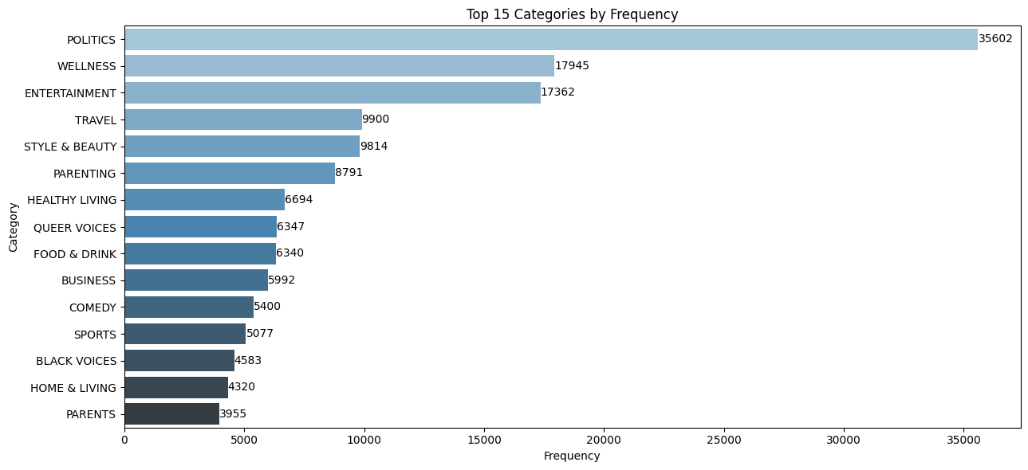
Exploratory Data Analysis (EDA)
Top 5 Category Frequency: Politics, Wellness, Entertainment, Travel, Style and Beauty.
Overlapping Categories (cosine):
"WELLNESS" & "HEALTHY LIVING" : 96%
PARENT" & "PARENTING" : 97%
Copyright © 2023 Grazitti Interactive. The Information on the deck is proprietary to Grazitti Interactive.
Any reproduction or distribution of the content without the company's consent is prohibited and may cause legal action.
‹#›
Notes:
Now, let’s uncover some fascinating insights from our dataset.
First, I looked at the distribution of articles across different categories. Here's what I found – the top 5 categories dominating our headlines:
Politics
Wellness
Entertainment
Travel
Style and Beauty
As I was analyzing this data, an interesting thought crossed my mind: ‘Isn’t “parenting” and “parent” essentially the same category, just labeled differently?’ I wondered if there were other similar cases.
To explore this, I used cosine similarity and discovered some fascinating results:
‘Wellness’ and ‘Healthy Living’ are 96% similar
‘Parent’ and ‘Parenting’ are 97% similar
Based on these findings, I decided to combine the categories.

Slide 14
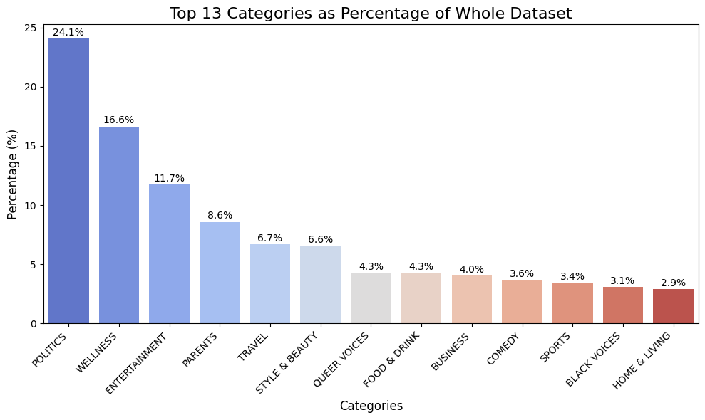
News Category Buckets
Politics: Accounts for 24.1% of the whole dataset.
Top 5 Categories: Politics, Wellness, Entertainment, Parents and Travel cover more than 50% of the news articles.
Interest Trends: Beyond political coverage, the articles shift their attention to health and entertainment topics.
Copyright © 2023 Grazitti Interactive. The Information on the deck is proprietary to Grazitti Interactive.
Any reproduction or distribution of the content without the company's consent is prohibited and may cause legal action.
‹#›
Notes:
Our dataset tells a fascinating story of news trends. [Engaging tone]
Politics dominates, accounting for 24.1% of our entire dataset. But here's the interesting part - our top 5 categories:
Politics
Wellness
Entertainment
Parents
Travel
These categories collectively cover over 50% of our news articles.
Beyond political coverage, we observed a clear shift: articles increasingly focus on health and entertainment topics." [End with an intriguing tone]

Slide 15
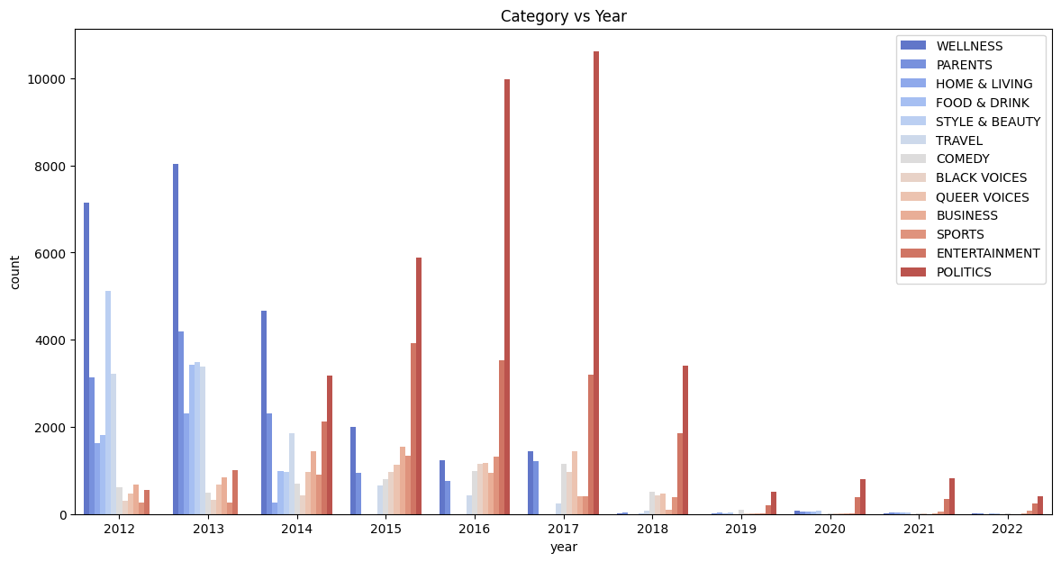
News Category Trends Over Time
Peak in 2016-2017: Significant peaks in categories like Politics, Entertainment, and Sports.
Earlier Years (2012-2014): Frequent publications in categories like Wellness, Parents, and Food & Drink.
Decline Post-2017: Less data is available after 2017, around 10,000 records.
Copyright © 2023 Grazitti Interactive. The Information on the deck is proprietary to Grazitti Interactive.
Any reproduction or distribution of the content without the company's consent is prohibited and may cause legal action.
‹#›
Notes:
Our dataset reveals fascinating temporal news trends:
Peak Period (2016-2017):
Significant spikes in Politics, Entertainment, and Sports categories
Intense media coverage during this period
Earlier Years (2012-2014):
High frequency in Wellness, Parents, and Food & Drink categories
Post-2017 Trend:
Significant data decline
Approximately 10,000 records remaining" [Use confident, analytical tone]

Slide 16
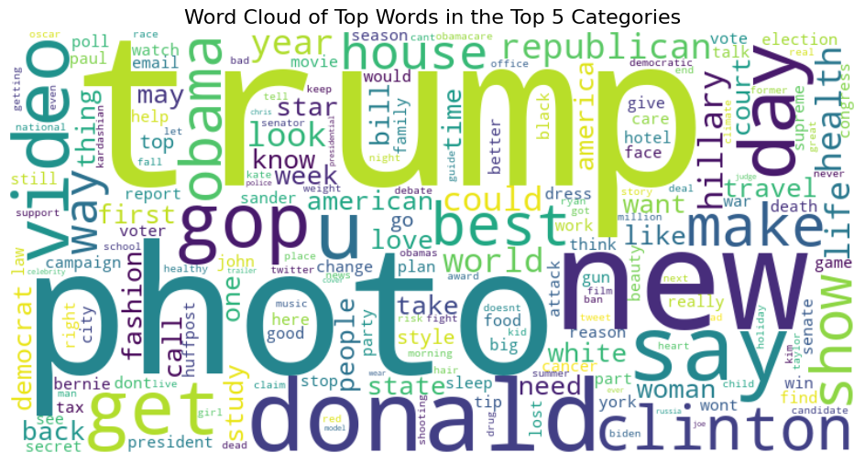
Category-Specific Word Trends
Politics
Most frequent words: "Donald”, ”Trump", “Republican”
Wellness
Most frequent words: "Health", "Life,", “Food”
Entertainment
Most frequent words: "Movie", "Video", “Star”
Parenting
Most frequent words: "Mom", "Dad", “Baby”
Travel
Most frequent words: "Hotel", "Vacation", “Photo”
Copyright © 2023 Grazitti Interactive. The Information on the deck is proprietary to Grazitti Interactive.
Any reproduction or distribution of the content without the company's consent is prohibited and may cause legal action.
‹#›
Notes:
Breaking down the most frequent words by category:
Politics:
Top words: Donald, Trump, Republican
Wellness:
Key terms: Health, Life, Food
Entertainment:
Prominent words: Movie, Video, Star
Parenting:
Frequent terms: Mom, Dad, Baby
Travel:
Recurring words: Hotel, Vacation, Photo" [Deliver with crisp, informative style]

Slide 17

Data Preparation To Enhance Model Prediction
Copyright © 2023 Grazitti Interactive. The Information on the deck is proprietary to Grazitti Interactive.
Any reproduction or distribution of the content without the company's consent is prohibited and may cause legal action.
‹#›
Notes:
Now, let's explore how we prepared the data to improve the accuracy and performance of our model

Slide 18
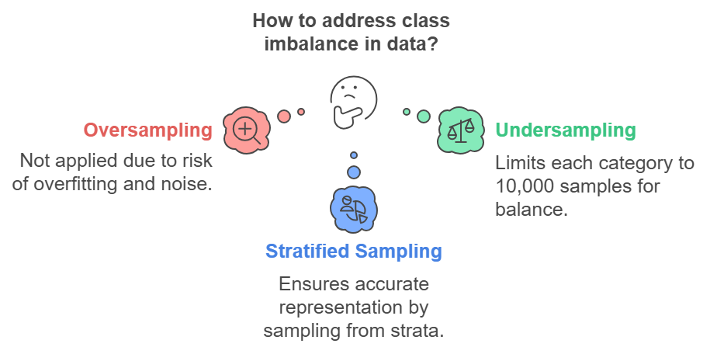
Data Preparation
Data Preprocessing:
Stop Word Removal: Eliminate common stop words.
Example: "The cat is on the mat" → "cat mat"
Lemmatization: Convert words to their base form.
Example: "running" → "run"
Tokenization: Split text into individual words (tokens).
Example: "The cat" → ["The", "cat"]
Data Partition:
Training Data: 80%
Test Data: 20%
Copyright © 2023 Grazitti Interactive. The Information on the deck is proprietary to Grazitti Interactive.
Any reproduction or distribution of the content without the company's consent is prohibited and may cause legal action.
‹#›
Notes:
Now, let’s walk through the key data preprocessing techniques we used to ensure the model performs at its best.
First, we remove stop words—these are common, but meaningless words that don’t contribute much to the model. For example, in the sentence ‘The cat is on the mat’, we remove words like ‘the’ and ‘is’, leaving us with ‘cat mat’.
Next, we apply lemmatization—this converts words to their base form. So, ‘running’ becomes ‘run’, and ‘better’ becomes ‘good’. This helps the model understand the root meaning of words.
Then, we tokenize the text, which simply means splitting it into individual words or tokens. For instance, ‘The cat’ becomes [‘The’, ‘cat’]. This helps the model process the text more efficiently.
For the data partitioning, we split the data into two sets:
Training Data: 80% of the dataset to train the model
Test Data: 20% to evaluate the model’s performance
Finally, we address the class imbalance in the data. Since some categories might have fewer examples than others, we use techniques like:
Oversampling (adding more instances of underrepresented classes)
Undersampling (removing some instances from overrepresented classes)
Stratified Sampling (ensuring the class distribution is similar across both training and test data)

Slide 19
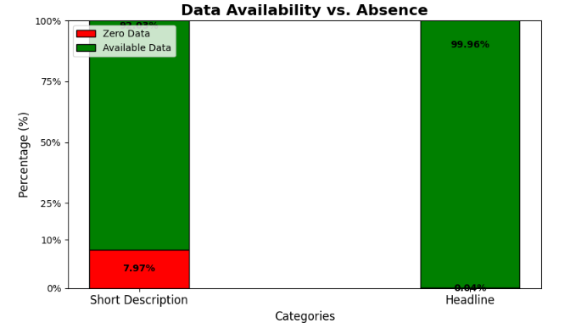
Variable Selection for Training Model
Initially selected Short Description for model training due to larger dataset
Analysis revealed 7.97% missing data in Short Description
Switched to Headline column with only 0.04% missing values
Copyright © 2023 Grazitti Interactive. The Information on the deck is proprietary to Grazitti Interactive.
Any reproduction or distribution of the content without the company's consent is prohibited and may cause legal action.
‹#›
Notes:
"During our model training, we made a critical strategic decision. [Confident tone]
Initially, we planned to use the Short Description column. However, our analysis revealed a significant challenge - 7.97% of these descriptions were missing.
[Decisive pivot] We quickly switched to the Headline column, which had only 0.04% missing values. This ensures our model's training data is robust and comprehensive." [Use hand gesture to emphasize the strategic shift]

Slide 20

Deep Dive Into Model Insights and Selection
Copyright © 2023 Grazitti Interactive. The Information on the deck is proprietary to Grazitti Interactive.
Any reproduction or distribution of the content without the company's consent is prohibited and may cause legal action.
‹#›
Notes:
Let’s see which model I trained, its results, and which one came out on top

Slide 21
Model Performance Comparison
Traditional Machine Learning:
The model used is Logistic Regression.
Deep Learning Model:
Bi-LSTM Model
The embedding layer has an input dimension of 10,000.
It consists of two Bi-LSTM layers with a dropout rate of 0.3.
RoBERTa
 | Logistic Regression ( % ) | Bi-LSTM ( % ) | RoBERTa ( % )
Accuracy | 74.73 | 73.00 | 80.42
Precision | 75.04 | 72.67 | 80.38
Recall | 74.73 | 72.68 | 80.42
F1 Score | 74.03 | 72.61 | 80.36
Copyright © 2023 Grazitti Interactive. The Information on the deck is proprietary to Grazitti Interactive.
Any reproduction or distribution of the content without the company's consent is prohibited and may cause legal action.
‹#›
Notes:
Machine Learning Models:
Traditional: Logistic Regression
Deep Learning: Bi-LSTM
Embedding layer: 10,000 input dimension
Two Bi-LSTM layers
Dropout rate: 0.3
Transfer Learning: RoBERTa

Slide 22
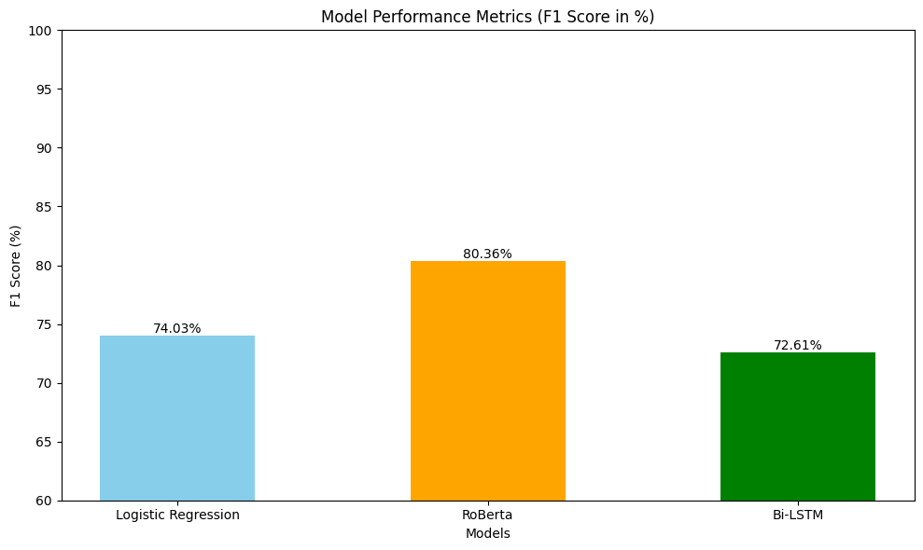
RoBERTa "Champion Model" Based on F1 Scores
The RoBERTa model achieved an F1 score of 80.36%, demonstrating its strong performance.
Model Training Hyperparameters:
Epochs: 5
Batch Size (Train & Eval): 16
Warm Up-Steps: 500
Weight Decay: 0.01
Logging & Evaluation:
Logging Steps: Every 10 steps
Evaluation Strategy: End of each epoch
Model Saving: Enabled
Copyright © 2023 Grazitti Interactive. The Information on the deck is proprietary to Grazitti Interactive.
Any reproduction or distribution of the content without the company's consent is prohibited and may cause legal action.
‹#›
Notes:
F1 Score: 80.36%
Training Hyperparameters:
Epochs: 5
Batch Size: 16
Warm-Up Steps: 500
Weight Decay: 0.01
Logging & Evaluation:
Log every 10 steps
Evaluate each epoch
Model saving: Disabled

Slide 23
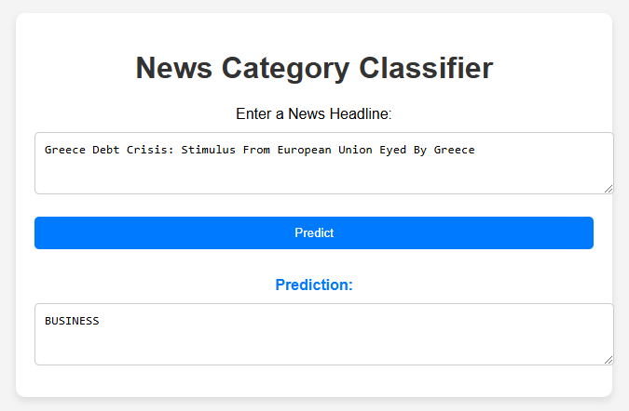
Model Showcase
Copyright © 2023 Grazitti Interactive. The Information on the deck is proprietary to Grazitti Interactive.
Any reproduction or distribution of the content without the company's consent is prohibited and may cause legal action.
‹#›
Notes:
Feedback

Slide 24

Challenges Faced and Strategic Opportunities for Growth
Copyright © 2023 Grazitti Interactive. The Information on the deck is proprietary to Grazitti Interactive.
Any reproduction or distribution of the content without the company's consent is prohibited and may cause legal action.
‹#›

Slide 25



Challenges
Computational Resources
Managing computational resources and time for training deep learning models on Kaggle or Colab.
03
Class Imbalance
Undersampling: Reduced majority class instances to match the minority class for balanced data.
01
02
Model Optimization
Each model required extensive fine-tuning to achieve optimal performance.
Copyright © 2023 Grazitti Interactive. The Information on the deck is proprietary to Grazitti Interactive.
Any reproduction or distribution of the content without the company's consent is prohibited and may cause legal action.
‹#›

Slide 26
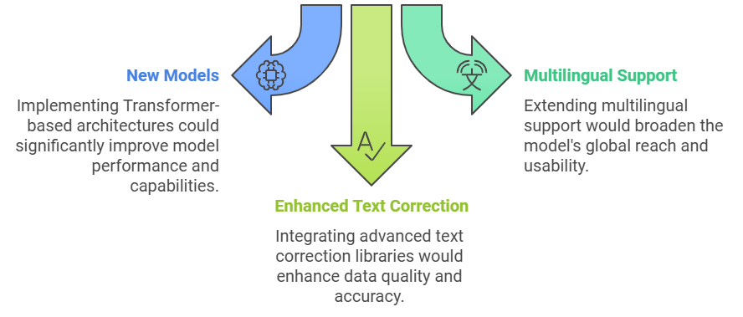
Future Scope for Better Category Prediction
Copyright © 2023 Grazitti Interactive. The Information on the deck is proprietary to Grazitti Interactive.
Any reproduction or distribution of the content without the company's consent is prohibited and may cause legal action.
‹#›
Notes:
Feedback

Slide 27

THANKS

Slide 28
Appendix

Slide 29
Impact of AI on Business Operations
Cost Optimization
25-30% Cost Reduction: Businesses automating tasks with AI report significant cost savings by eliminating manual processes.
Production Costs Lowered by 20%: AI-driven predictive analytics reduces waste and optimizes resource use.
Operational Efficiency
30-40% Efficiency Gains: Companies adopting AI experience faster processing and error-free outcomes.
44% Productivity Boost: Automation tools significantly streamline workflows, improving overall output.
Sources: Reports from McKinsey.
Copyright © 2023 Grazitti Interactive. The Information on the deck is proprietary to Grazitti Interactive.
Any reproduction or distribution of the content without the company's consent is prohibited and may cause legal action.
‹#›
Notes:
Feedback

Slide 30
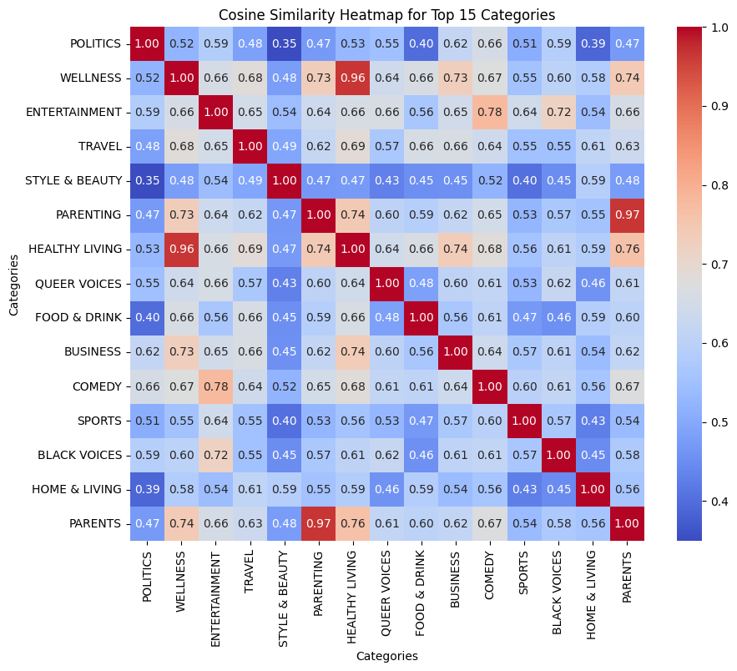
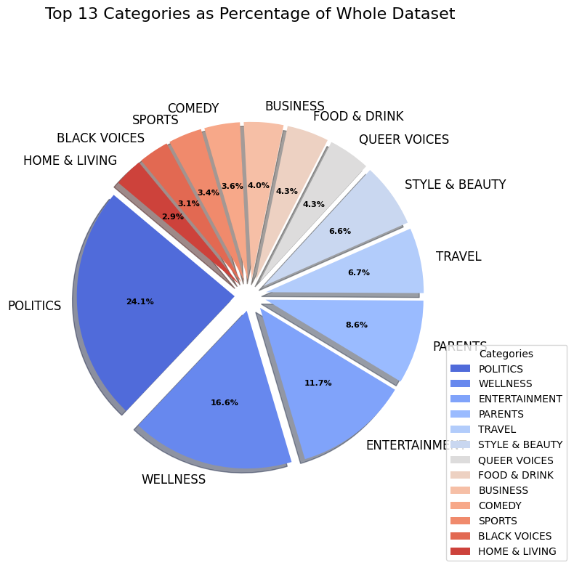
EDA
Copyright © 2023 Grazitti Interactive. The Information on the deck is proprietary to Grazitti Interactive.
Any reproduction or distribution of the content without the company's consent is prohibited and may cause legal action.
‹#›
Notes:
Feedback

Slide 31
Understanding Model Evaluation Metrics
Accuracy
Definition: Number of correct predictions divided by total predictions
Example : Out of 1000 predictions, 850 were correct (Accuracy = 850/1000 = 85%)
Use Case: Best used when classes are balanced (similar number of likes/dislikes)
Precision
Definition: Out of all positive predictions, how many were actually positive?
Example:Model flagged 100 emails as spam, 95 were actually spam, 5 were important emails (Precision = 95/100 = 95%)
Use Case: Critical when false positives are costly. High precision means users won't miss important messages
Copyright © 2023 Grazitti Interactive. The Information on the deck is proprietary to Grazitti Interactive.
Any reproduction or distribution of the content without the company's consent is prohibited and may cause legal action.
‹#›
Notes:
Feedback

Slide 32
Understanding Model Evaluation Metrics
Recall (Sensitivity)
Definition: Out of all actual positive cases, how many did we catch?
Example:Hospital has 100 patients with cancer, Model identified 98 of them (Recall = 98/100 = 98%)
Use Case:Preferred when false negatives are very costly. High recall ensures we catch nearly all cancer cases.
F1 Score
Definition: Harmonic mean of precision and recall.
F1 Score = 2 * (Precision * Recall) / (Precision + Recall)
Use Case: Perfect for fraud detection where both missing fraud and false alarms are costly.
Copyright © 2023 Grazitti Interactive. The Information on the deck is proprietary to Grazitti Interactive.
Any reproduction or distribution of the content without the company's consent is prohibited and may cause legal action.
‹#›
Notes:
Feedback

Slide 33
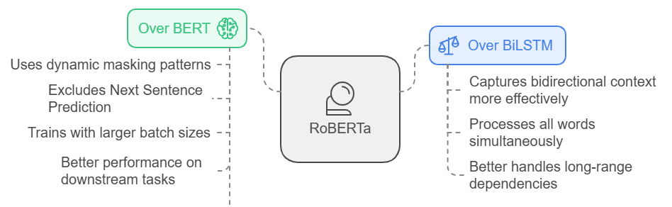
Understanding RoBERTa
What is RoBERTa?
An enhanced language model by Facebook AI that improves BERT's performance through better training strategies.
Uses transformer architecture with self-attention to understand context, trained on 160GB diverse text data.
Copyright © 2023 Grazitti Interactive. The Information on the deck is proprietary to Grazitti Interactive.
Any reproduction or distribution of the content without the company's consent is prohibited and may cause legal action.
‹#›
Notes:
Feedback

Slide 34
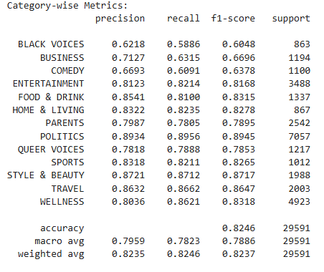
Category Wise Metrics
Top 5 Categories with F1-Score Above 0.80:
Categories like "POLITICS", "ENTERTAINMENT," and "PARENTS" have an F1-score above 0.80, showing strong performance.
Good Performance with Smaller Datasets:
Categories with fewer examples, such as "QUEER VOICES" and "BLACK VOICES," still maintain an F1-score above 0.60.
Copyright © 2023 Grazitti Interactive. The Information on the deck is proprietary to Grazitti Interactive.
Any reproduction or distribution of the content without the company's consent is prohibited and may cause legal action.
‹#›
Notes:
Feedback

